Slide 1
Employee Operation Manual

Slide 2
Table of Contents
Receive an Invitation
Password setting ・・・・・・・・・・・・・・・・p.4
First input ・・・・・・・・・・・・・・・・p.8
Receive an input request
Procedure for joining the company ・・・・・・・・・・・・・・・・p.10
Procedure for leaving the company ・・・・・・・・・・・・・・・・p.11
Request for updating information ・・・・・・・・・・・・・・・・p.12
Request for a procedure
Change of dependents ・・・・・・・・・・・・・・・・p.14
Change of address ・・・・・・・・・・・・・・・・p.16
Change of name ・・・・・・・・・・・・・・・・p.17
Share files
Receive a signature/seal request ・・・・・・・・・・・・・p.19
Download files ・・・・・・・・・・・・・・・・p.20
Upload files ・・・・・・・・・・・・・・・・p.21
Account Settings
Request for change of employee information ・・・・・・・p.23
Change of password ・・・・・・・・・・・・・・・・p.24
Others
Item lists for entering employee information ・・・・・・・p.26
Clock Revision Request Mail ・・・・・・・・・・・・・p.28

Slide 3
Issue My Page
Issue My Page
Enter the information for the first time

Slide 4
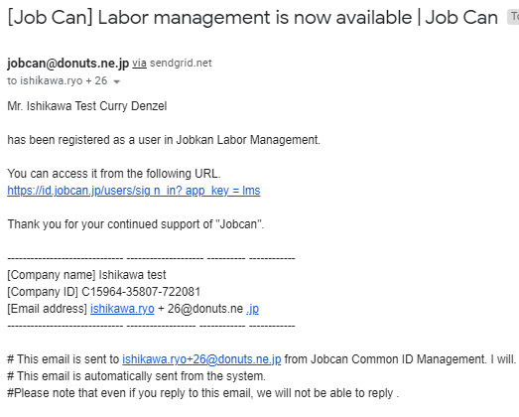
Issue My Page
You can request changing your profile, dependent, address and name on My Page of Jobcan Labor Management.
There are three patterns for issuing My Page. We will be introducing each operational procedures.
【１】When you have already used other Jobcan services
【２】When you use Jobcan for the first time
【３】When the manager requests to input profile at the same time as issuing My Page
【１】When you have already used other Jobcan services
1. Click the link from the invitation email.
If you have My Page in Jobcan series (Attendance Management, Work Flow/Expense Reimbursement, Recruitment Management, Payroll), you will receive the following email when the manager issues the new My Page for Labor Management.

Slide 5
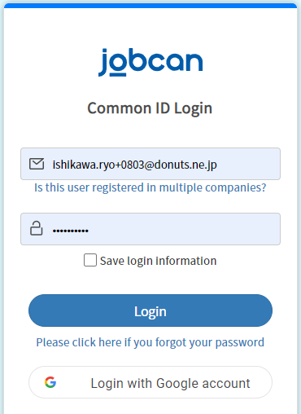
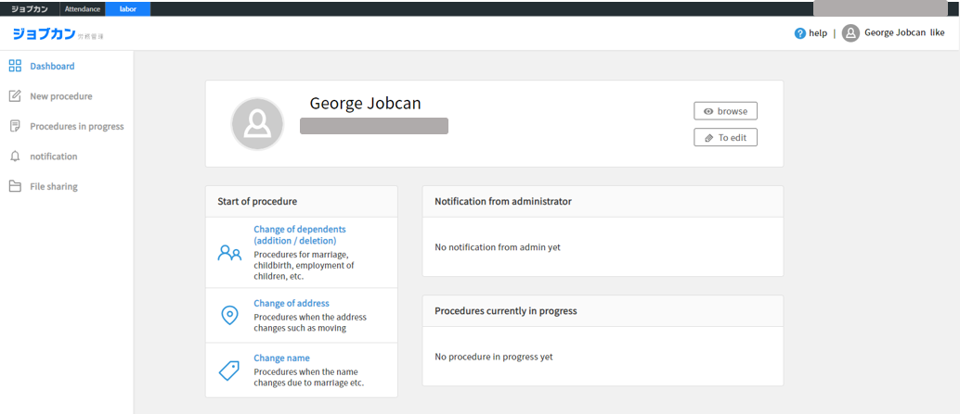
Issue My Page
2. Enter the email address and password to login.
When the top page of My Page of Labor Management is displayed, it will be available.

Slide 6
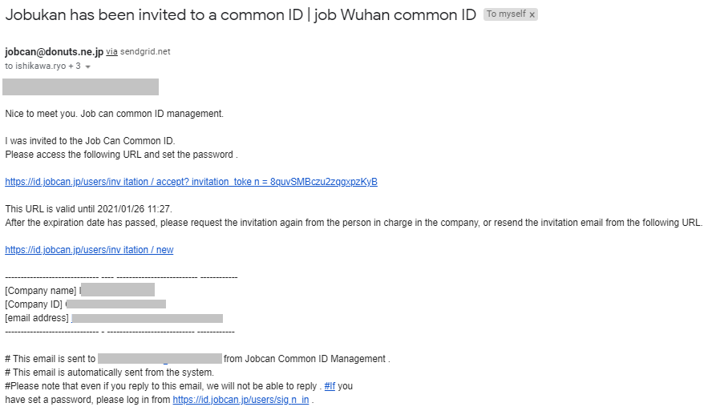
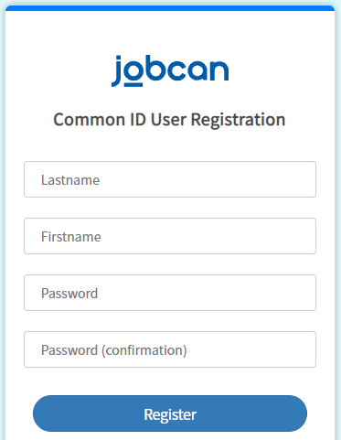
Issue My Page
【２】When you use Jobcan for the first time
1. Click the link in the invitation email.
If you use Jobcan series (Attendance Management, Work Flow/Expense Reimbursement, Recruitment Management, Payroll) for the first time, you will receive the following email when the manager issues new My Page for Labor Management.
Title：Jobcan has been invited to a common ID｜Jobcan Common ID
2. Enter the password and click “Register”.

Slide 7
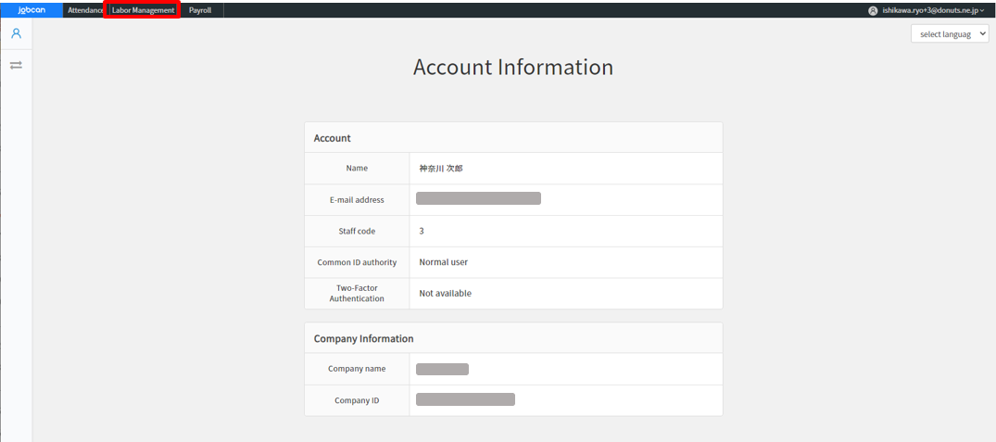
Issue My Page
3. My page of Jobcan common ID will be displayed, so click the “Labor Management” tab on the upper left.
When the top page of My Page of Labor Management is displayed, it will be available.

Slide 8
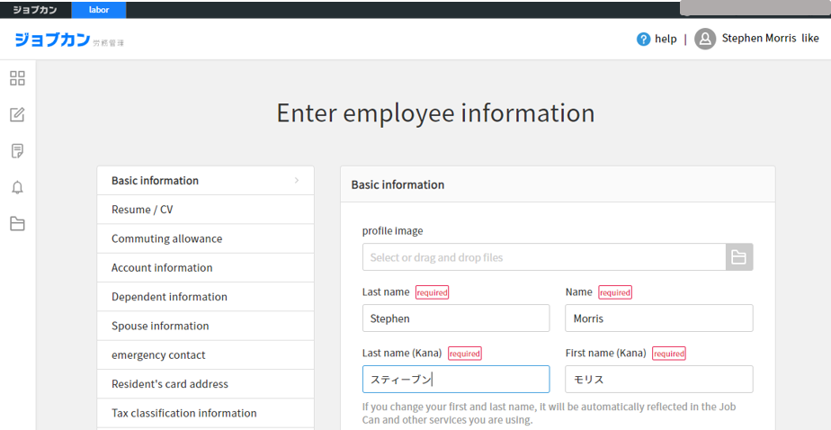
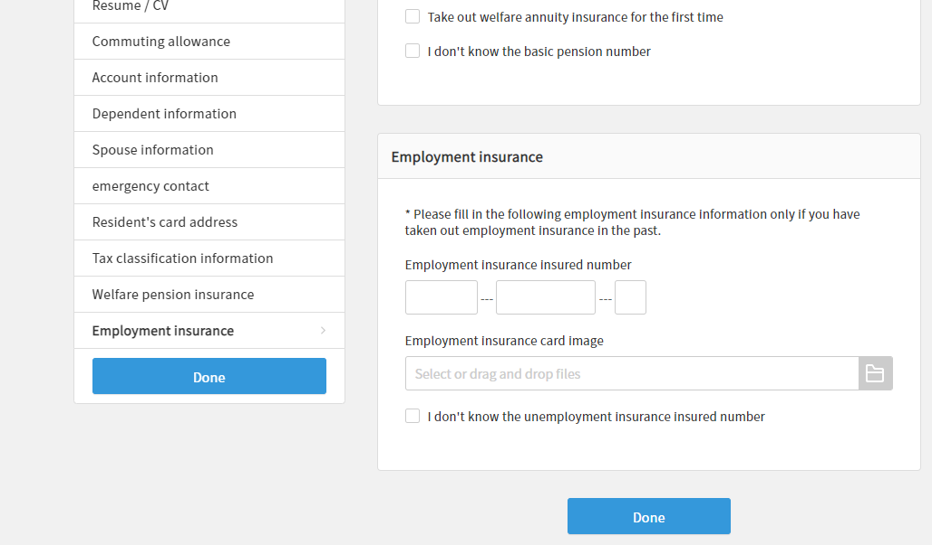
Enter the information for the first time
【３】When there is a request for entering profile from the manager at the same time as issuing My Page
When the manager issues My Page, the employee may be asked to enter a profile at the same time. In that case, when you log in to Jobcan Labor Management for the first time, page of “Enter employee information” will be displayed.
When you have finished entering the information, click the “Done” button at the bottom to complete.
* Upon entering, the manager may send you a revision request, so please enter the information again from the notification of the revision request and submit it to the manager.

Slide 9
Receive an input request
・Procedure for joining the company
・Procedure for leaving the company
・Request for updating information

Slide 10
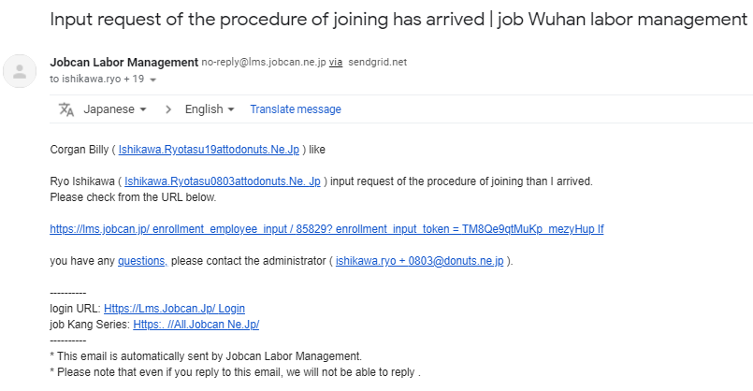
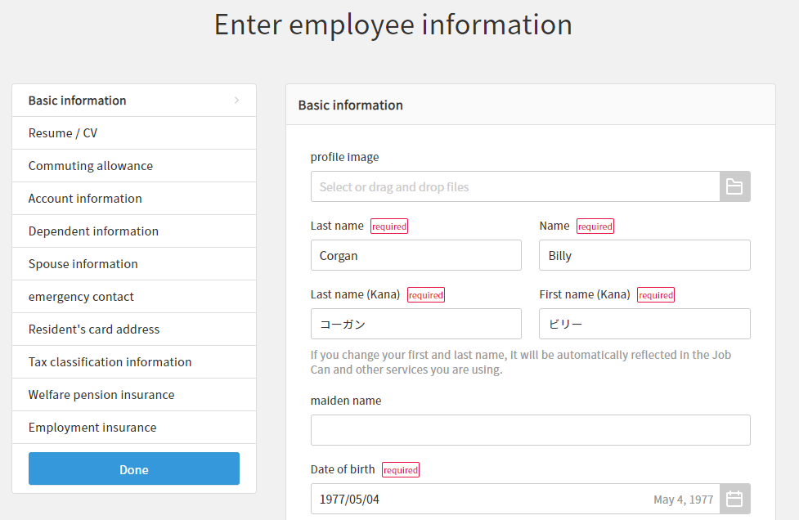
Procedure for joining the company
1. When you receive the email requesting input of the procedure for joining the company, click the link.
Email address
Email address
Email address
Email address
2. The input screen will be displayed, so enter the information.
* The input screen of the procedure for joining the company can be displayed from “Notification“ on the left menu.
3. Click “Done” and wait for the approval of the manager.
For details on the input items, see the list of employee information input items on page 26.

Slide 11
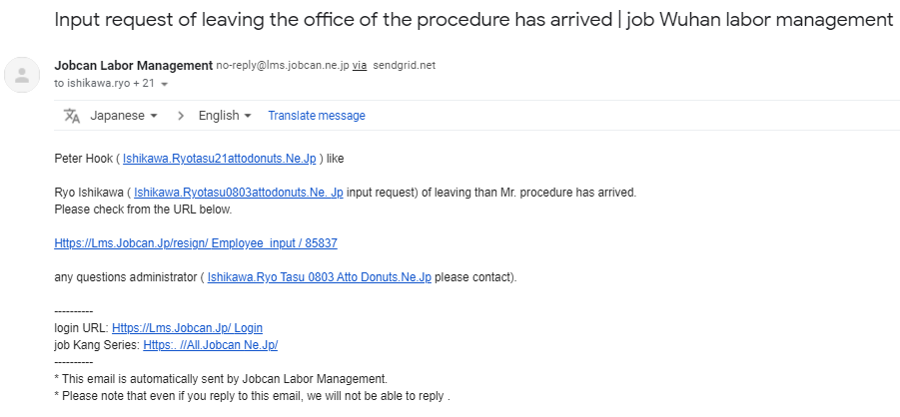
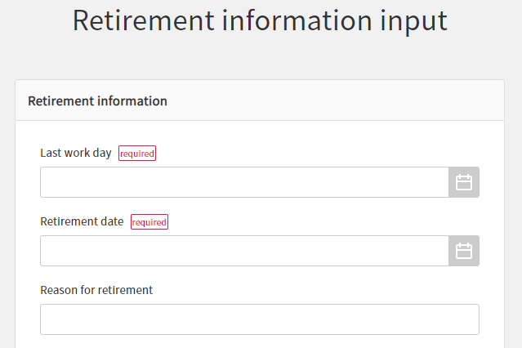
Procedure for leaving the company
1. When you receive the email requesting input of the procedure for leaving the company, click the link.
Email address
Email address
Email address
2. Enter the required information and click “Done” at the bottom to finish. Please wait for the approval of the manager.
We will introduce you about each item.
Retirement Information
Last work day | (E.g.) 2017/11/29
Retirement date | (E.g.) 2017/11/30
Reason for retirement | (E.g.) For personal reasons.
Address after retirement | (E.g.) 9-99-99, Jobcan apartment, Shibuya, Tokyo
Email address for contact after retirement | (E.g.) yamada@lms.jobcan.ne.jp
Phone number | (E.g.) 0000-0000-0000
How to hand over the withholding slip | ・Email ・Send by post
How to collect residence tax | ・ Request for special collection (salary deduction) at the new job ・ Request for normal collection (pay the remaining residence tax by myself) ・ Request for lump sum collection (lump sum deduction at the last salary)
Whether or not to need slip of unemployment | ・Yes ・No
Confirmation of getting insurance after retirement | ・I want to continue voluntarily ・I do not want to continue voluntarily
Return date of health insurance card | (E.g.) 2017/11/30
I lost my health insurance card | Please check the box if you lost it.
Name of next workplace (optional) | Input is arbitrary.
Joining date of next workplace (optional) | Input is arbitrary.
Remarks | Please fill in if there is anything.

Slide 12
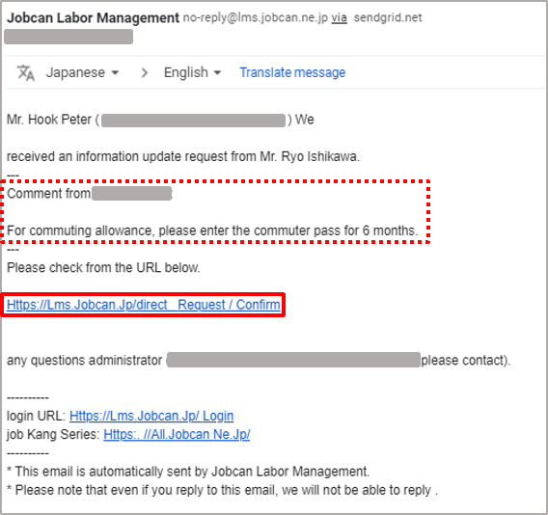
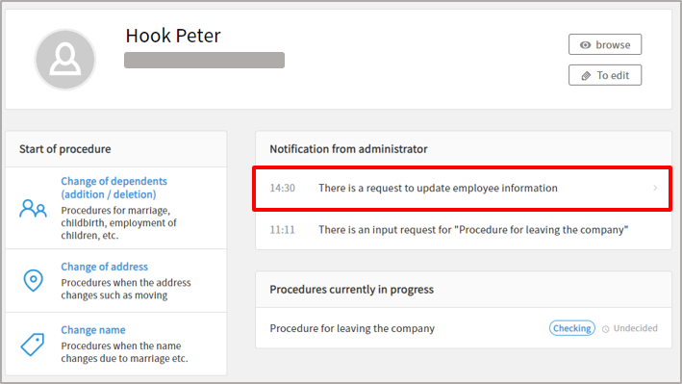
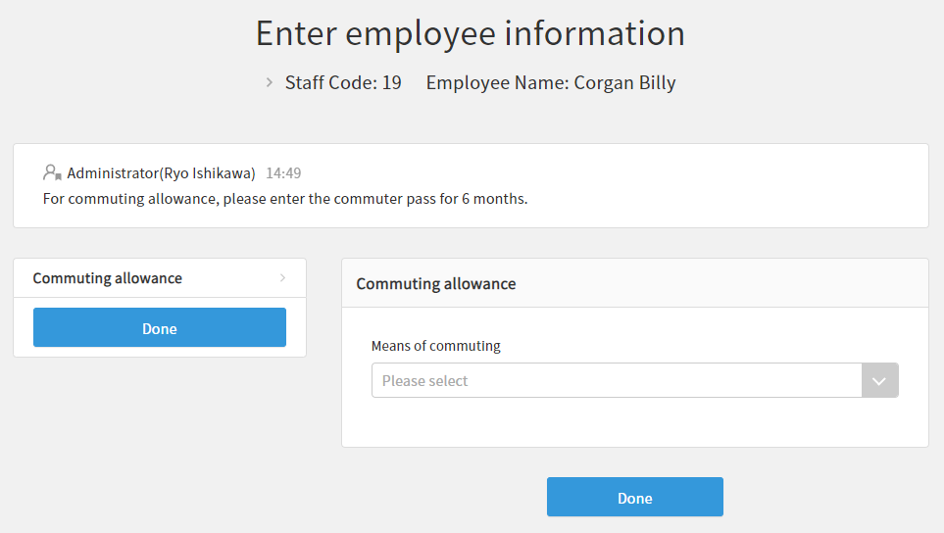
Request for updating information
You may receive a request from the manager to enter particular items. Please enter the information of the item specified from the email or the notification sent on My Page and submit it to the manager.
1. Click the link in the email or the notification on My Page.
2. Enter the items displayed and click “Done”. Please wait for the approval of the manager.

Slide 13
Request for a procedure
Change of dependents
Change of address
Change of name

Slide 14
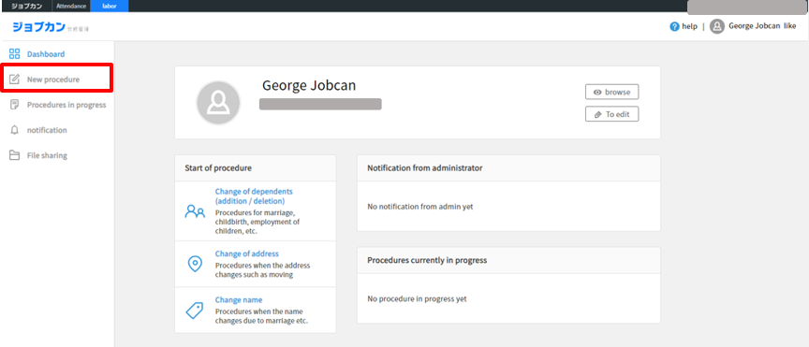
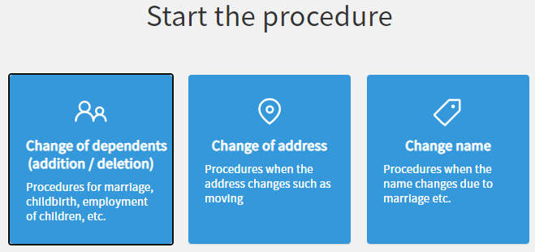
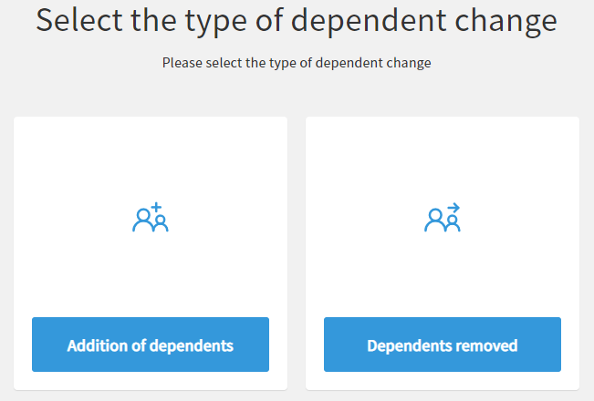
Change of dependent
1. Select the “New procedure” from the left menu.
2. Click “Change of dependents”.
3. Click “Add” or “Remove” and enter the required information.
For details on the input items, see "Addition of dependents" on the next page.
4. Click the "Apply" button to complete. Please wait for the approval of the manager.

Slide 15
Explanation of input items for change of dependents
＜Input items when adding dependents＞
Dependent transfer date
The day she/he became a dependent | (E.g.)2017/1/1
Dependent information
Dependents Relationship | Spouse/Other
Last name | (E.g.)Yamada
First name | (E.g.)Hanako
Date of birth | (E.g.)1980/1/1
Gender | Male/Female
Live together / Separate | Live together / Separated (domestic) / Separated (overseas)
Occupation | (E.g.)Housewife
Phone number | (E.g.)0000-0000-0000
Annual income (expected for the next year) | Half-width number
Annual income (January-December) | Half-width number
Disability classification | Not applicable / Person with disabilities / Person with heavy handicap
Dependent on tax | If dependent’s annual income (January-December) exceeds 380,000 yen, please uncheck it.
Reasons for being added to dependents | Please enter within 24 characters.
＜ Input items when removing dependents ＞
Dependent transfer date
The day she/he is no longer a dependent | (E.g.)2017/1/1
Dependent information
Please check the people who are out of support | Please select it.
Reasons for being out of support | ・Death ・Divorce ・Employment/Income increase ・Reached 75 years old ・Disability certification ・Other
Details of the reason | Please enter within 24 characters.

Slide 16
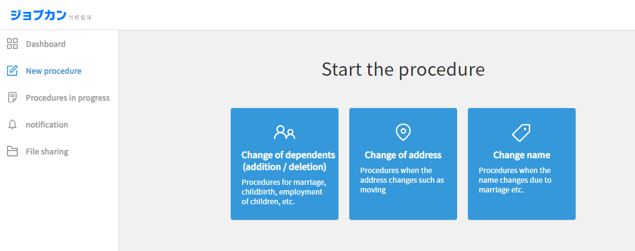

Change of address
1. Click “Change of address” from “New Procedure” on the left menu.
Enter each item, click “Apply” at the bottom to complete.
Moving day
Moving day | (E.g.)2017/1/1
Address before change
Please check if there is no mistake.
New address
Postal code | 999-9999
Prefectures | (E.g.)Tokyo
City | (E.g.)Shibuya
House Number | (E.g.)9-99-99
Building name/Room number | (E.g.)Jobcan Apartment
Resident's card is also updated | Check if you update it.
Commuting allowance
Means of commuting | Please select it.
Period of commuter pass | 1 month / 3 months / 6 months
Train Station you get in | (E.g.)Shibuya
Station you get off | (E.g.)Shinjuku
Waypoint | (E.g.)Yoyogi
One-way fare | Half-width number
Commuter pass fee | Half-width number
Bus Stop you get in | (E.g.)Shibuya
Stop you get off | (E.g.)Shinjuku
Waypoint | (E.g.)Yoyogi
One-way fare | Half-width number
Commuter pass fee | Half-width number
Car Departure place | (E.g.)Home
Arrival place | (E.g.)Head office
One-way commuting distance | Please select it.
Payment amount | Half-width number
Spouse’s address
Also change the address of dependent spouse | Check if it is changed.
Spouse’s address before change | Live together / Separated (domestic) / Separated (overseas)
15

Slide 17
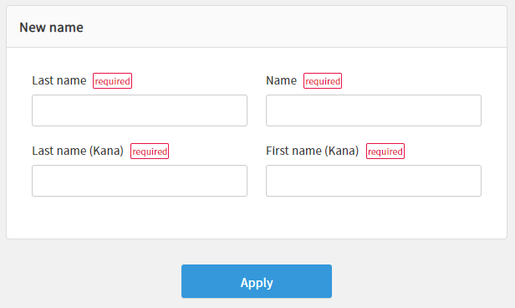
Change of name
1. Click “Change name” from “New Procedure” on the left menu.
2. Enter each item.
Date you change the name
Date you change the name | (E.g.)2017/1/1
Name before change
Please check if there is no mistake.
New name
Last name | (E.g.)Yamada
First name | (E.g.)Hanako
3. Click "Apply" and please wait for the approval of the manager.

Slide 18
Share files
Receive a signature/seal request
Download files
Upload files

Slide 19
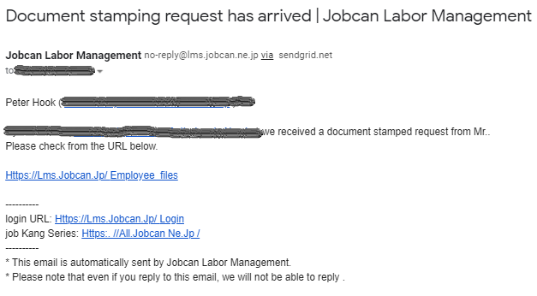
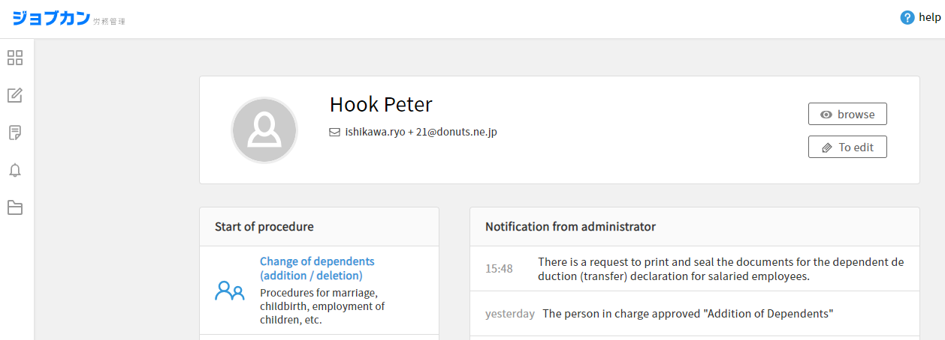
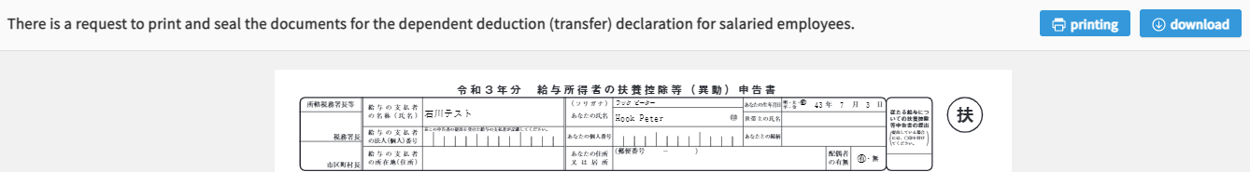
Receive a signature/seal request
When joining the company or changing dependents, the manager may request the employee to sign and seal the form.
1. When you receive an requesting email for sealing, click the link.
2. Click “There is a request to print and seal the documents for the dependent deduction (transfer) declaration for salaried employees.” from the notification on the Dashboard.
3. Print out the form, sign and seal it, and submit it to the manager.

Slide 20
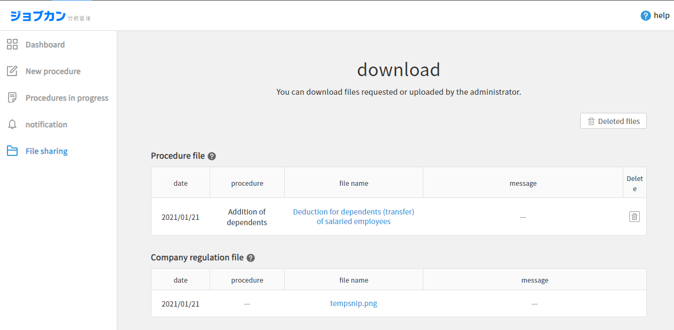
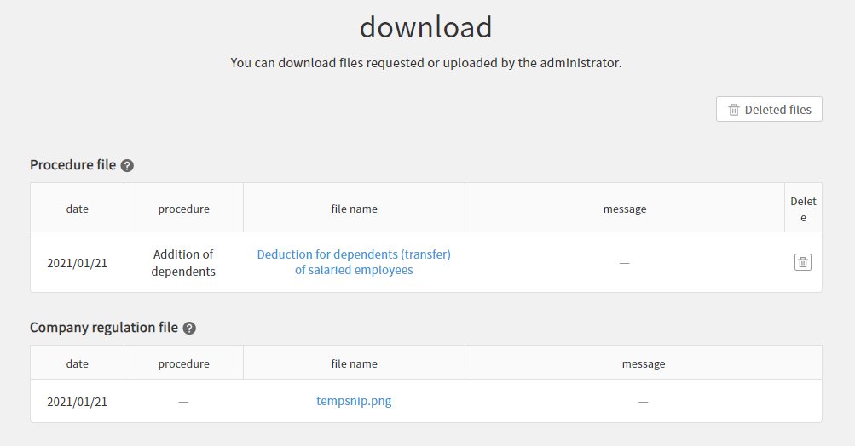
Download files
1. Select “File sharing” from the left menu bar.
2. Click the file name you want to download.

Slide 21
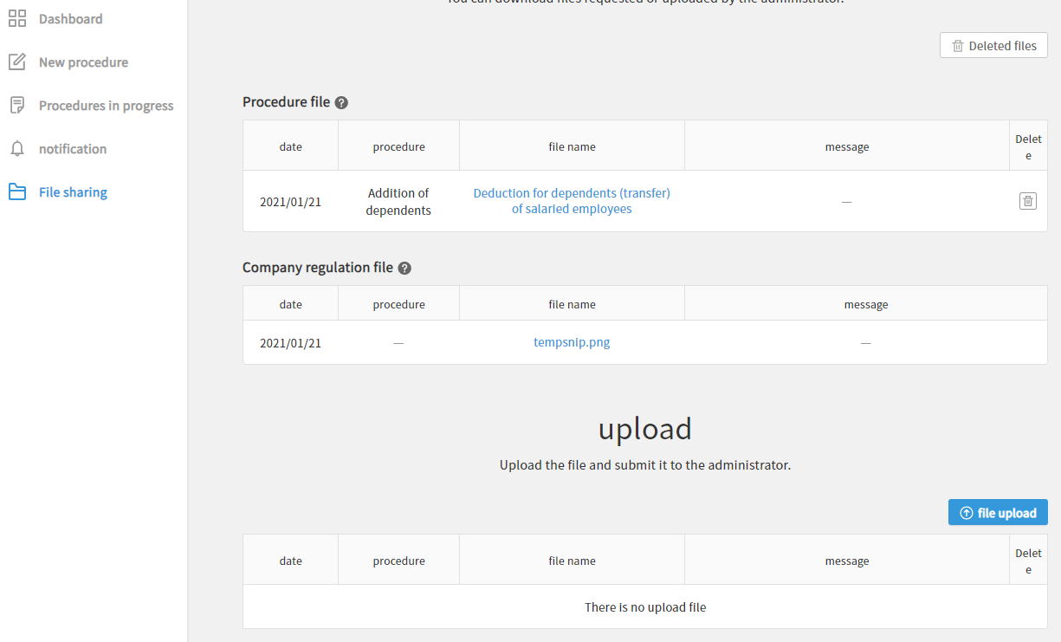
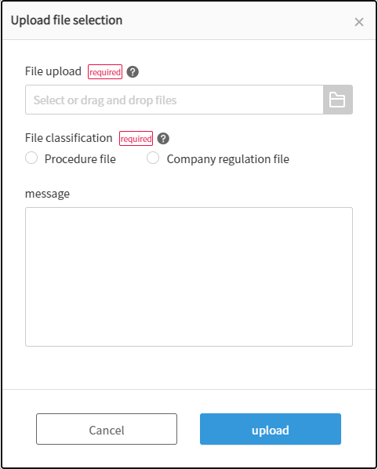
Upload files
1. Select “File sharing” on the left menu bar and click
“File upload”.
2. Upload the file, select “File classification”, and click the “upload” button to submit the file to manager.

Slide 22
Account Settings
Request for change of employee information
Change of password

Slide 23
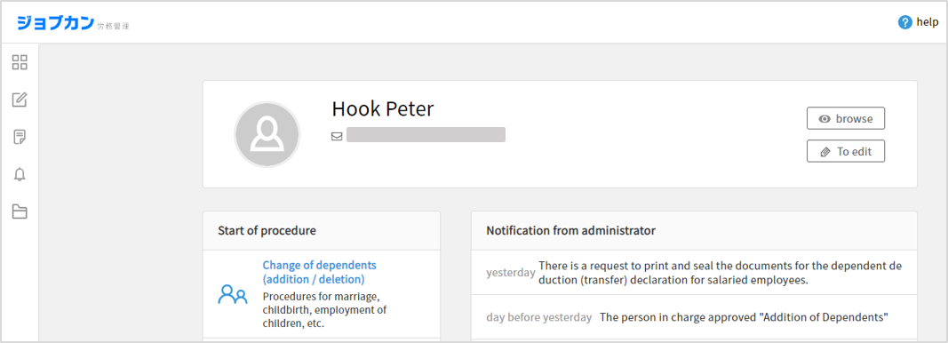
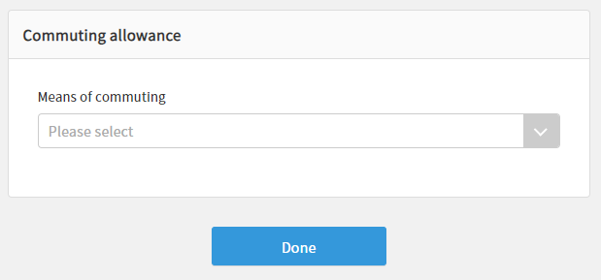
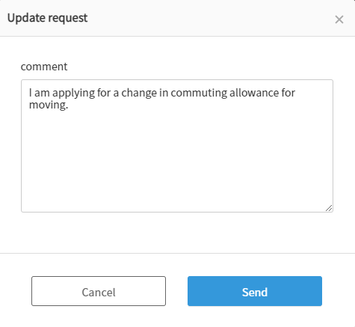
Request for change of employee information
1. Click “Dashboard” on the left menu, click “Edit”.
2. Change the information and click “Done”.
* The displayed items differ depending on the settings of the manager.
3. Enter a comment and click “Send“ to complete. Please wait for the approval of the manager.

Slide 24
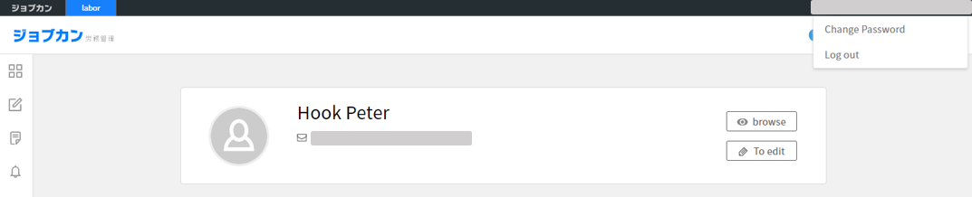
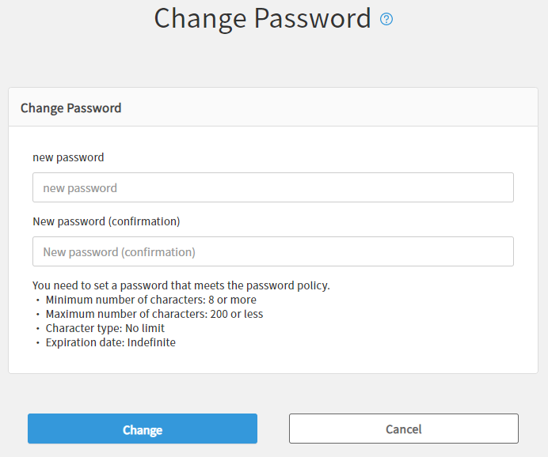
Change of password
1. Click the email address at the top right of My Page and click “Change password” from the displayed menu.
2. Enter new password and click “Change” to complete.

Slide 25
Others
Item lists for entering employee information
Clock Revision Request Mail

Slide 26
Item lists for entering employee information
* Items may be customized by the manager
Item name | Condition | Explanation
Basic information
Profile image | Optional | Please upload your face photo.
Last name | Required | (E.g.) Yamada
First name | Required | (E.g.)Taro
Maiden name | Optional | (E.g.)Taro Sasaki
Date of birth | Required | (E.g.)1980/1/1
Gender | Required | Male / Female
Email address | Optional | (E.g.)yamada@lms.jobcan.ne.jp
Country of Residence | Optional | Please select it.
Postal code | Required | 999-9999
Prefectures | Required | (E.g.)Tokyo
City | Required | (E.g.)Shibuya
Street number | Required | (E.g.)9-99-99
Building name/Room number | Optional | (E.g.)Jobcan apartment
Address (overseas) | Required (Applicable person only) | Half-width alphanumeric character
Phone number | Optional | (E.g.)0000-0000-0000
Relationship of householder | Optional | (E.g.)The person himself/herself, husband, wife, etc.
Name of householder | Optional | (E.g.)Taro Yamada
Japanese/Non-Japanese | Optional | Please select it.
Nationality/Region | Optional (Applicable person only) | Please select it.
Status of residence | Optional (Applicable person only) | Please select it.
Expiration date of stay | Optional (Applicable person only) | (E.g.)2011/4/1
Whether or not there is permission for activities outside the qualification | Optional (Applicable person only) | Yes / No
Temporary/Contract employment classification | Optional (Applicable person only) | Please select it.
Residence card | Optional (Applicable person only) | Please select the file.
Resume / CV
Resume / CV | Optional | Please select the file.
Commuting allowance
Means of commuting | Optional | Please select it.
Commuter pass period | Optional (Applicable person only) | One month / Three months / Six months
Train | Station you get in | Optional (Applicable person only) | (E.g.)Shibuya
Station you get off | Optional (Applicable person only) | (E.g.)Shinjuku
Waypoint | Optional (Applicable person only) | (E.g.)Yoyogi
One-way fare | Optional (Applicable person only) | Half-width number
Commuter pass fee | Optional (Applicable person only) | Half-width number
Bus | Stop you get in | Optional (Applicable person only) | (E.g.)Shibuya
Stop you get off | Optional (Applicable person only) | (E.g.)Shinjuku
Waypoint | Optional (Applicable person only) | (E.g.)Yoyogi
One-way fare | Optional (Applicable person only) | Half-width number
Commuter pass fee | Optional (Applicable person only) | Half-width number
Car | Departure place | Optional (Applicable person only) | (E.g.)Home
Arrival place | Optional (Applicable person only) | (E.g.)Main office
One-way commuting distance | Optional (Applicable person only) | Please select it.
Payment amount | Optional (Applicable person only) | Half-width number
Account information
Bank name | Optional | (E.g.)xx bank
Bank code | Optional | 4 half-width number
Branch name | Optional | (E.g.) Shinjuku Central Branch
Branch code | Optional | 3 half-width number
Type of account | Optional | Saving account / Current account
Account number | Optional | Within 7 half-width number

Slide 27
Item lists for entering employee information
Dependent information
With or without dependents | Optional | Yes / No
Relationship to the dependents | Required (Applicable person only) | Spouse / Others
Details of relationship | Required (Applicable person only) | Please select it.
Last name | Required (Applicable person only) | (E.g.)Yamada
First name | Required (Applicable person only) | (E.g.)Hanako
Date of birth | Required (Applicable person only) | (E.g.)1980/1/1
Gender | Required (Applicable person only) | Male/Female
Live together / Separate | Required (Applicable person only) | Live together / Separate / Separate (domestic) / Separate (overseas)
Occupation | Required (Applicable person only) | (E.g.)Housewife
Phone number | Optional (Applicable person only) | (E.g.)0000-0000-0000
Annual income (Expected for the next year) | Optional (Applicable person only) | Half-width number
Annual income (January - December) | Required (Applicable person only) | Half-width number
Disability classification | Optional (Applicable person only) | Not applicable / Person with disabilities / Person with heavy handicap
Dependent on tax | Optional (Applicable person only)
Day she/he become a dependent | Optional (Applicable person only) | In the procedure for joining the company, the date of joining the company will be automatically set.
Reason for being added to dependent | Optional (Applicable person only) | In the procedure for joining the company, “By acquiring qualification” will be automatically set.
Submission of dependent deduction report for subordinate salary | Optional
Spouse information
Whether or not you have spouse | Optional | Yes / No
Emergency contact
Last name | Optional | (E.g.)Yamada
First name | Optional | (E.g.)Ichiro
Relationship | Optional | (E.g.) The person himself/herself, Husband, Wife, etc.
Phone number | Optional | (E.g.)0000-0000-0000
Postal code | Optional | 999-9999
Prefectures | Optional | (E.g.)Tokyo
City | Optional | (E.g.)Shibuya
Street number | Optional | (E.g.)9-99-99
Building name/Room number | Optional | (E.g.)Jobcan apartment
Address of residence card
Postal code | Optional | 999-9999
Prefectures | Optional | (E.g.)Tokyo
City | Optional | (E.g.)Shibuya
Street number | Optional | (E.g.)9-99-99
Building name/Room number | Optional | (E.g.)Jobcan apartment
Tax classification information
Disability classification | Optional | Not applicable / Person with disabilities / Person with heavy handicap
Working student classification | Optional | Not applicable / Working student
Single parent/Widow (Widower) classification | Optional | Not applicable / Single parent / Widow (Widower)
Widow (Widower) classification (before 2020) | Optional | Not applicable / Widow (Widower) / Special Widow (Widower)
Single child dependent (before 2020) | Optional | Not applicable / Single child dependent
Health insurance
Health insurance insured person reference number | Optional | Within 6 half-width number
Welfare pension insurance
Basic pension number | Optional | 10 half-width number
Pension notebook image | Optional | Please select the file.
Take out welfare annuity insurance for the first time | Optional
I don't know the basic pension number | Optional
Employment insurance
Employment insurance insured number | Optional | 11 half-width number
Employment insurance card image | Optional | Please select the file.
Don’t know the employment insurance insured number | Optional

Slide 28
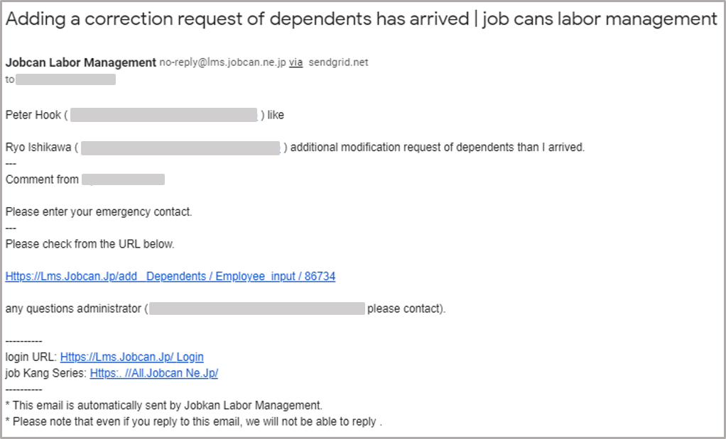
Clock Revision Request Mail
1. You may receive a request to correct the procedure from the manager.
Title: Adding a correction request of dependents has arrived｜Jobcan labor management
2. Check “Comment from xx”, click the link, correct the relevant part, and submit it to the administrator.

